Slide 1
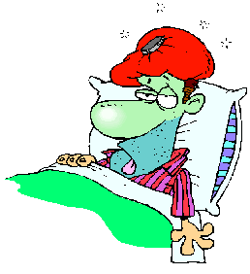
Imperatives
1
Health problems

Slide 2
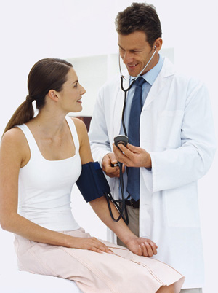
What do you do when you are sick ?

Slide 3
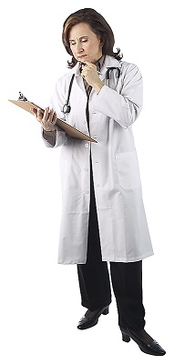
At the Dr’s
Please:
Rest well for a couple days.
Eat healthy and avoid oily foods.
Take these pills twice a day and
Do not drink alcohol or smoke.
Do what I say and you will get better soon.
In what tense (Verb form) are the Doctor’s orders ?

Slide 4
-Rest well for a couple days.
-Eat healthy food
-Take these pills twice a day
-Do not drink alcohol or smoke.
-Do it and you will get better soon.

Slide 5
Imperatives
1
Driving Safely
Focus on Grammar 1
Part 1, Unit I
By Ruth Luman, Gabriele Steiner, and BJ Wells
Copyright © 2006. Pearson Education, Inc. All rights reserved.

Slide 6
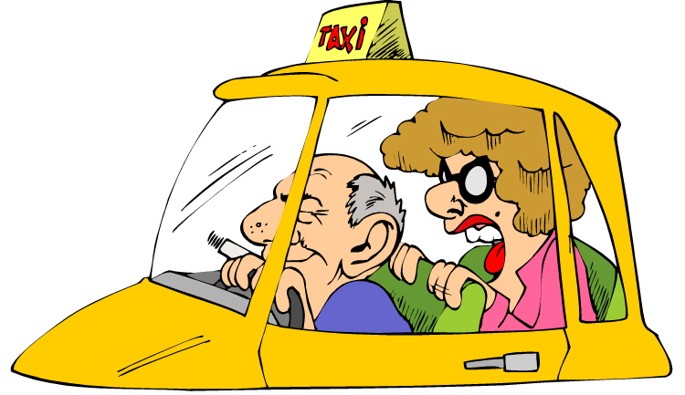
Driving Safely
Woman: Slow down, please! I’m nervous.
Driver: Relax. I’m a good driver.
Woman: Don´t answer your phone!
Driver: Don’t worry. Listen to the music.
Woman: There’s a red light. Stop!
Driver: Close your eyes. I’m driving this cab.
Woman: Turn right! No, turn left! No, right.
Driver: OK, here we are. Next time, please take a bus.

Slide 7
Use 1
Use the imperative for directions.
Stop!
Turn left.

Slide 8
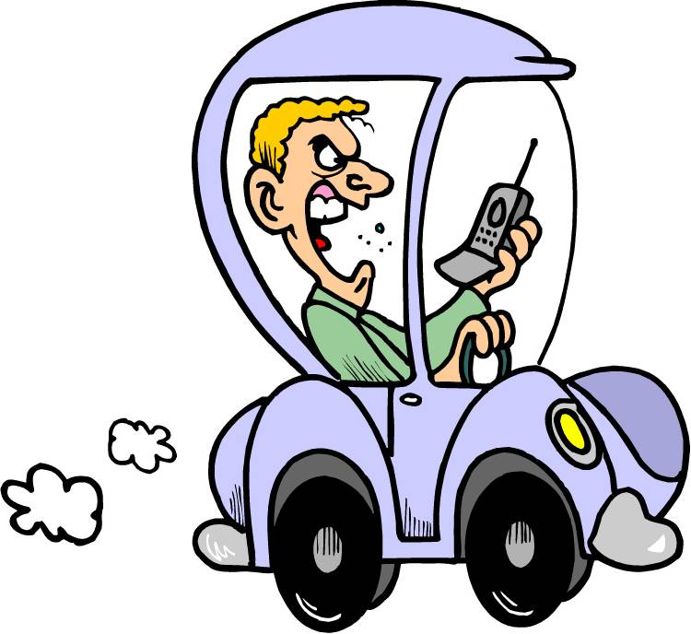
Use 2
Use the imperative for instructions.
Watch out for that bicycle.
Close your eyes!

Slide 9
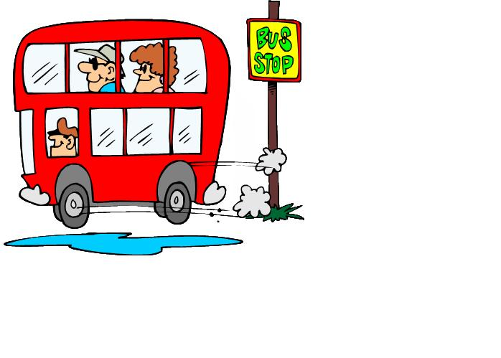

Use 3
Use the imperative for requests.
Please take the bus.
Please slow down.

Slide 10
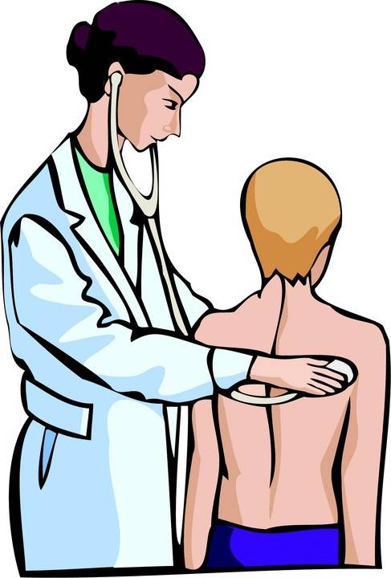
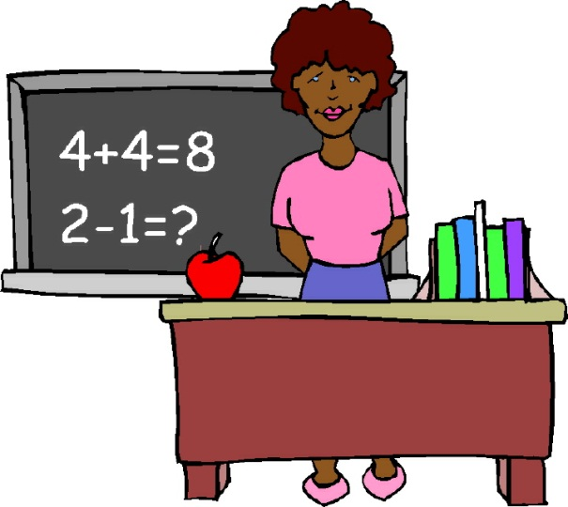
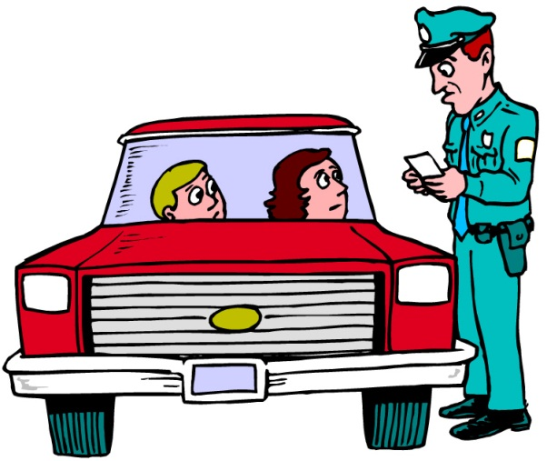
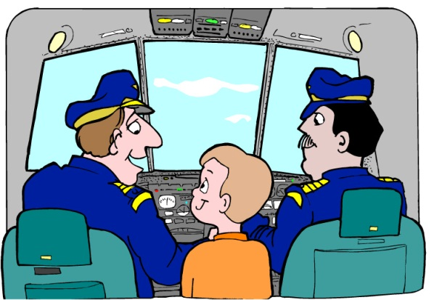
Practice 1
Match the instructions with the person who gives them.
Take a deep breath.
Read page 23 for homework.
Give me your driver’s license.
Take a deep breath.
Get ready for take-off.
Read page 23 for homework.
doctor
teacher
Give me your driver’s license.
Get ready for take-off.
police officer
pilot

Slide 11
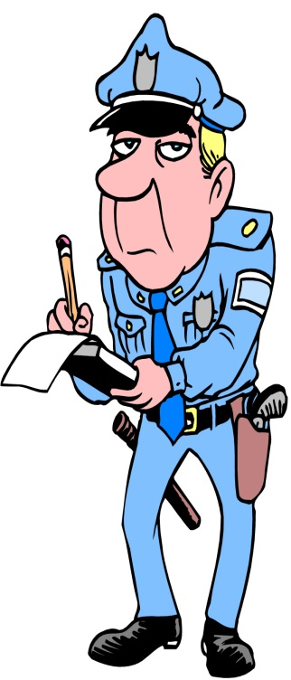
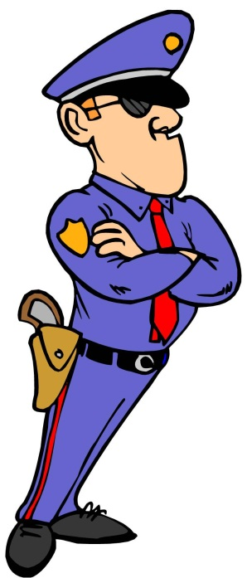
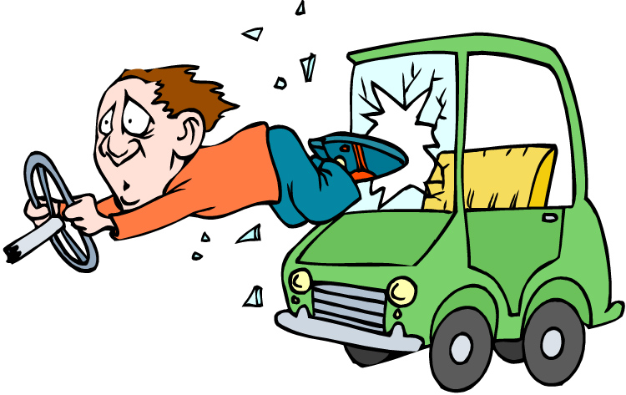
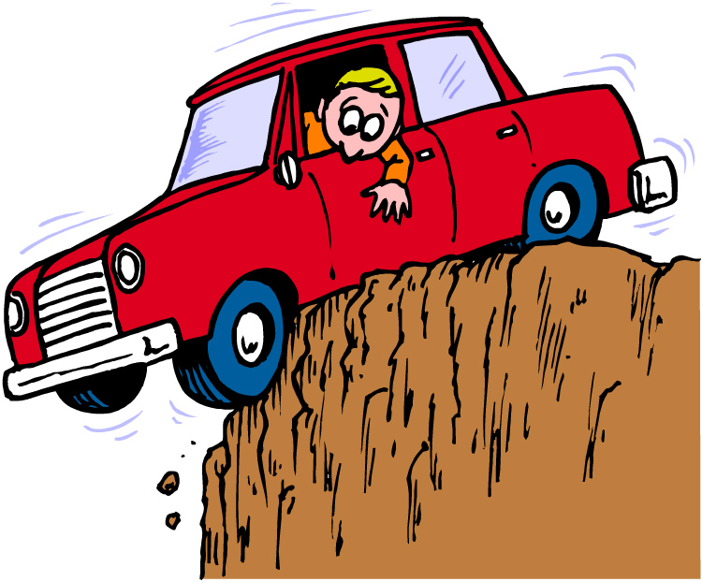
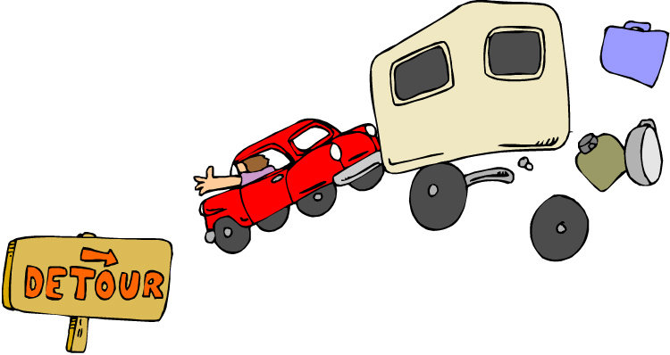
Affirmative
Use the base form of the verb for the imperative.
Follow road signs.
Use a seat belt.

Slide 12
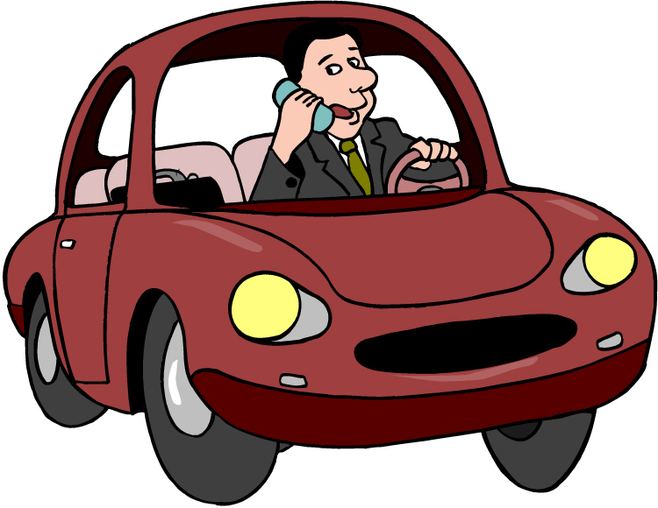
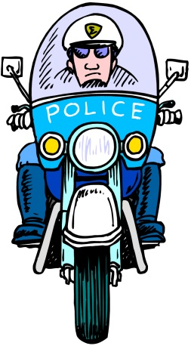
Negative
Use do not (don’t) + base form for the negative form of the imperative.
Don’t drive fast.
Don’t use a cell phone.

Slide 13
Practice 2
Make these imperatives negative.
Example: Park here.
Don’t park here.
1. Stop.
1. Don’t stop.
2. Pass on the left.
2. Don’t pass on the left.
3.Turn on your lights.
3. Don’t turn on your lights.
4. Exit here.
4. Don’t exit here.

Slide 14

Please
Please makes an imperative more polite. Please comes at the beginning or at the end of a sentence.
Watch out for animals, please.
Please watch out for animals.

Slide 15
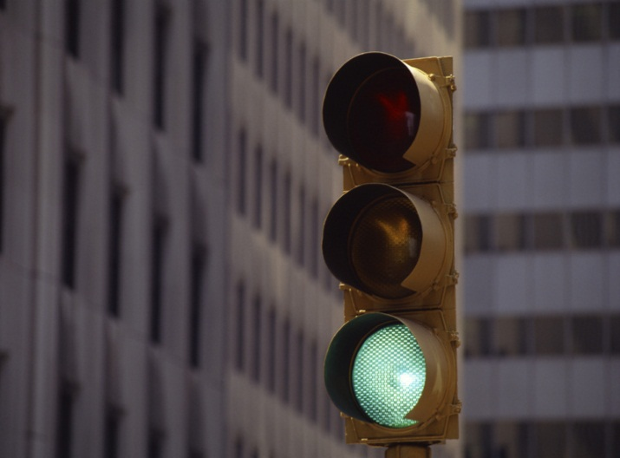
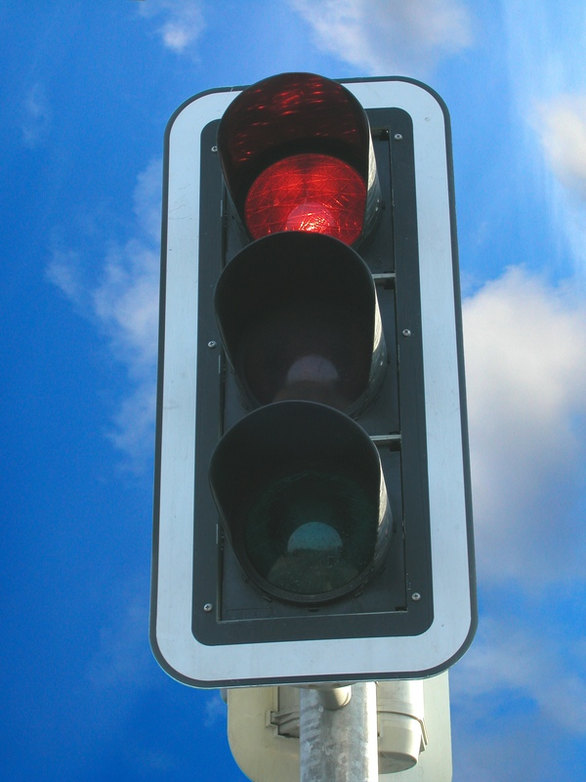
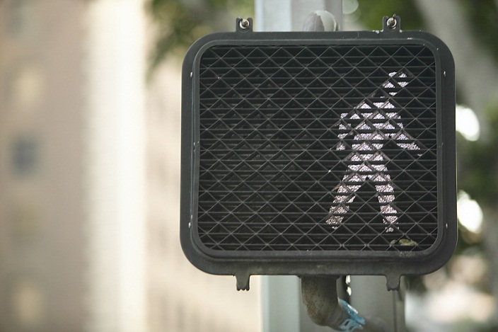
Practice 3A
Look at the signs. Make instructions with imperatives.
1.
Example:
1. Go.
Stop.
2.
2. Walk.

Slide 16
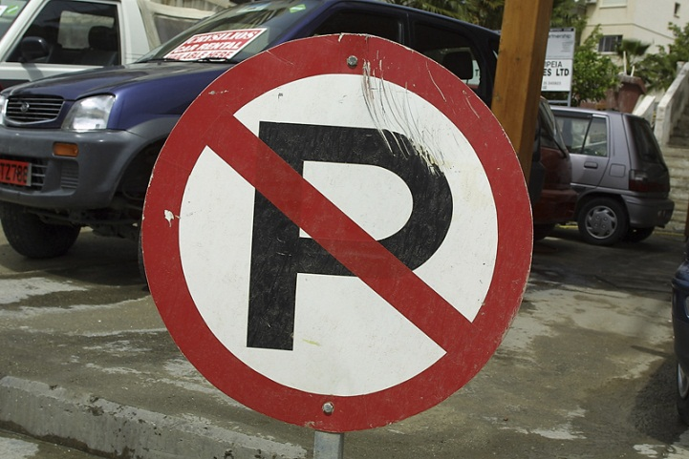

Practice 3B
Look at the signs. Write instructions with imperatives.
3.
3. Don’t park here.
4.
4. Turn right.

Slide 17
References
Copyright © 2006 Pearson Education and its licensors. All rights reserved.

